Slide 1

ReactJS
By Mycos Technologies

Slide 2



Mycos Technologies Company
Today's
Agenda
1
Intro Html/CSS/JS/TS
2
Basic React
3
Component/Event/State
4
Create the GAME!

Slide 3

Course Timeline
HTML/CSS
Javascript
Typescript
ReactJS
GAME TIME

Slide 4

Prerequisites/Tools/ Environments
NodeJS – v.16.15.0
NPM 8.5.5
VS Code
Git (optional)
Postman (optional)

Slide 5

Intro Html,CSS, JavaScript,TypeScript

Slide 6

HTML/CSS
What is HTML?
HTML Document Structure
Example HTML tags
Headings and Paragraphs
Text formatting
Links / Image
What is CSS?
Applying CSS in HTML document

Slide 7
What is HTML?
HyperText Markup Language
Language to define layout, content for website
Important terms
Element / Tag
Attribute

Slide 8
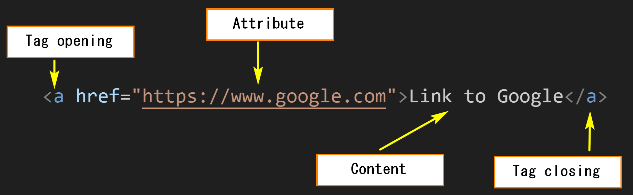
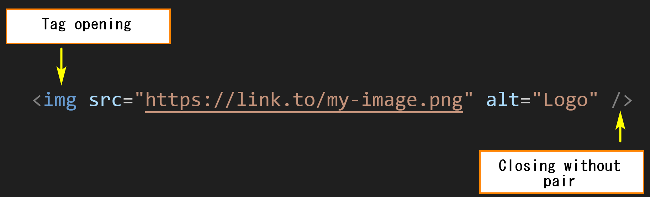
Tag / Element

Slide 9
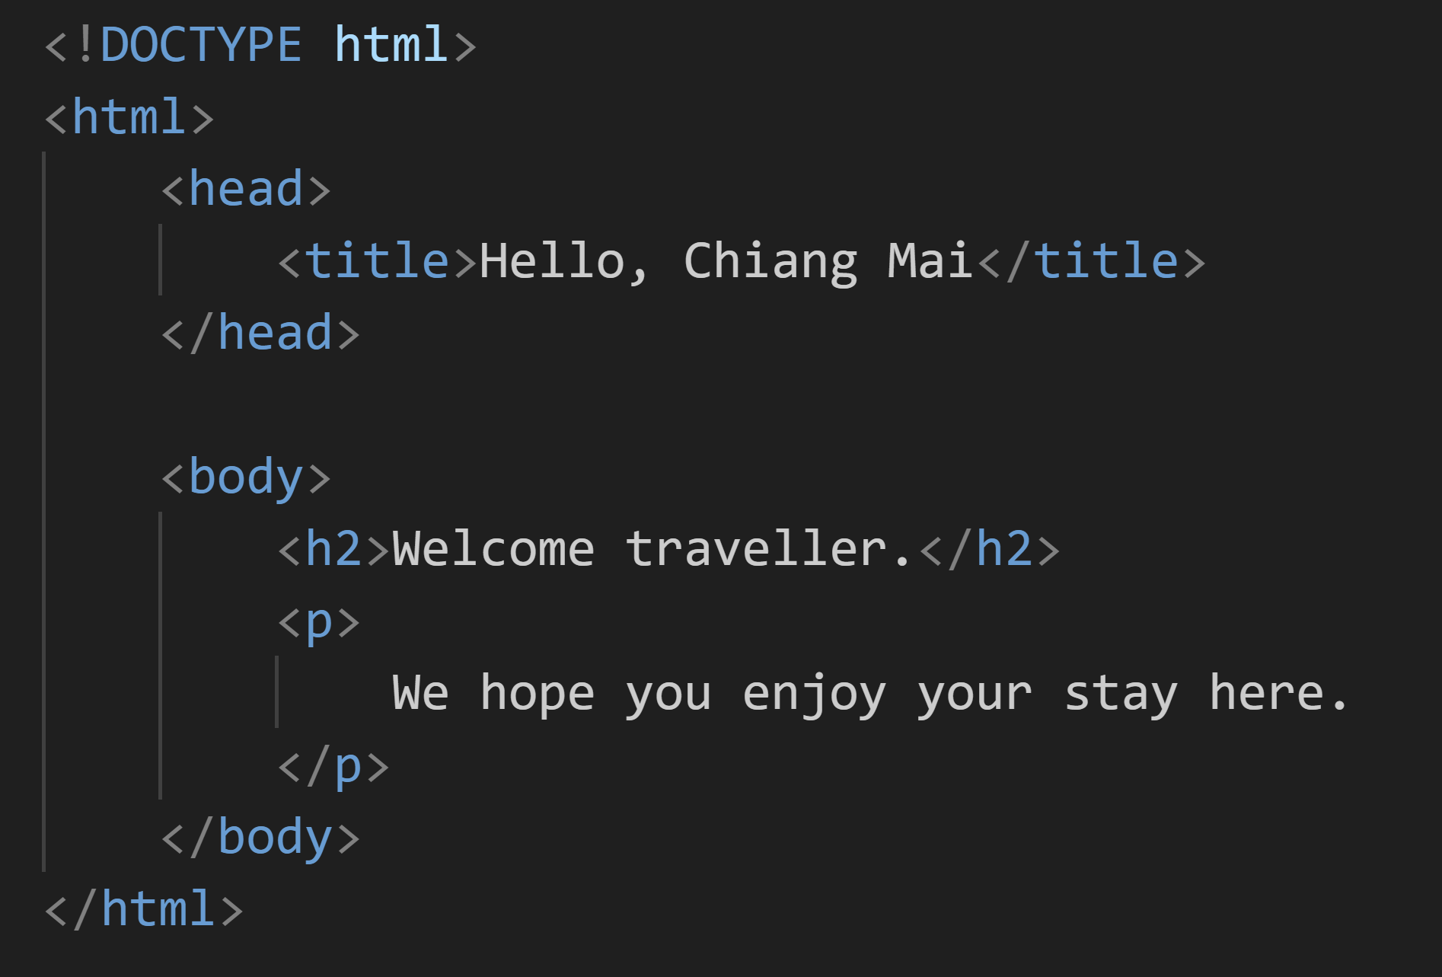
HTML Structure

Slide 10
Example: heading/paragraph
Using tag <h1>, <h2>, ..., <h6> to define heading
Using tag <p> to define paragraph
Using tag <br /> to line-breaking

Slide 11

Example: Text Formatting
<b> - Bold text
<strong> - Important text
<i> - Italic text
<em> - Emphasized text
<mark> - Marked text
<small> - Smaller text
<del> - Deleted text
<ins> - Inserted text
<sub> - Subscript text
<sup> - Superscript text

Slide 12
Example: Link / Image
<img /> - Insert image
`src` to specify source of image
<a>...</a> - Insert Link
`href` to specify target URL

Slide 13
What is CSS?
Cascading style sheets
Describes how HTML elements are to be displayed on screen
Control the layout of multiple web pages all at once
Can be stored in seperated CSS files
Types
Inline
Pre-defined CSS

Slide 14
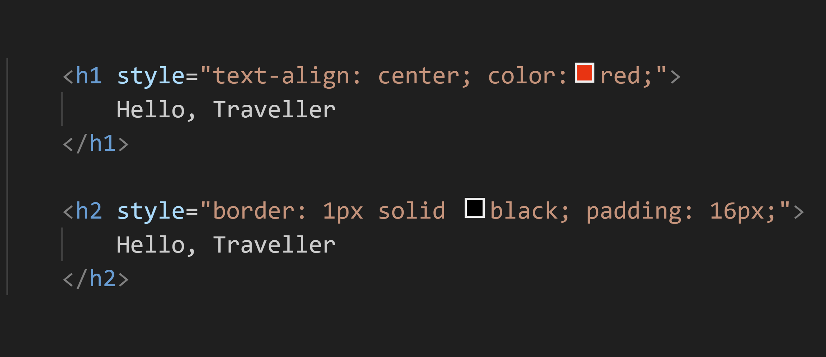
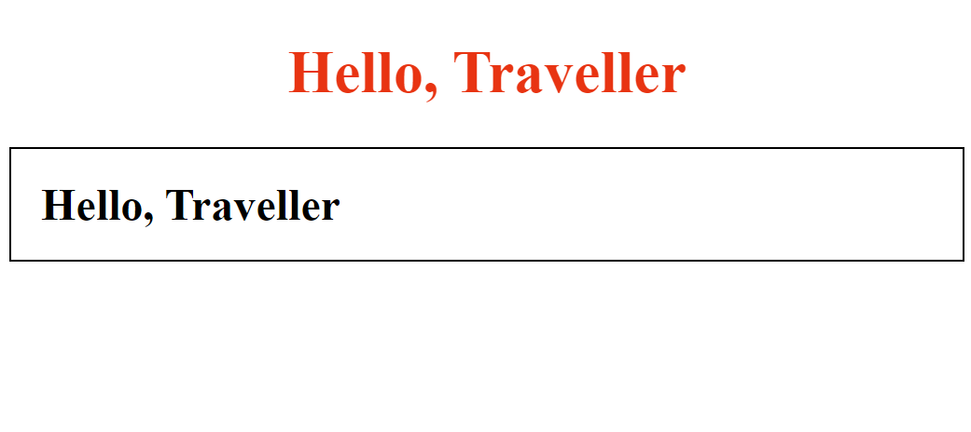
Example: Inline CSS

Slide 15
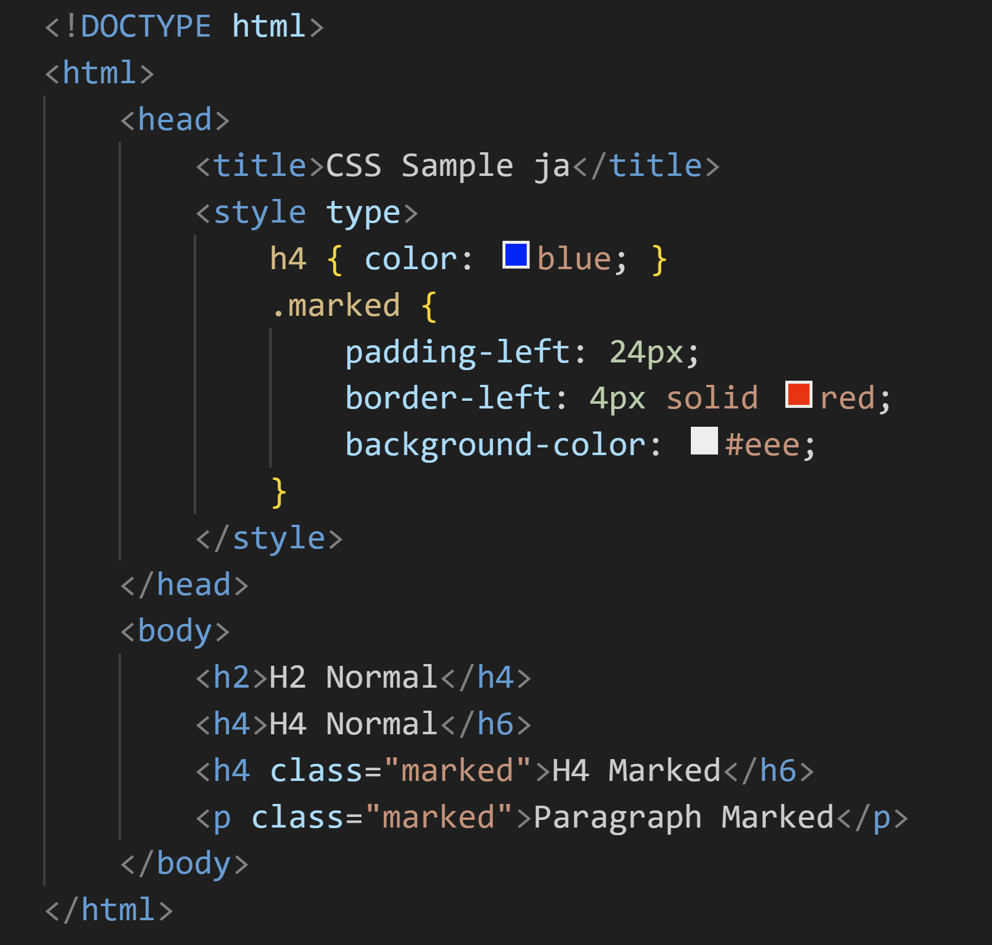
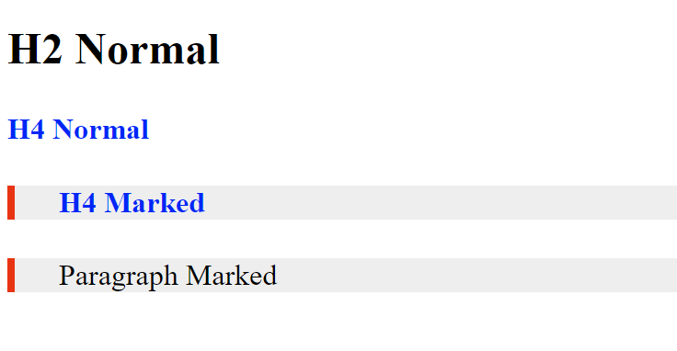
Example: Pre-defined CSS

Slide 16
JavaScript
HTML: Web Structure
CSS: Theming
Javascript
"Interactive & Business Logic"

Slide 17
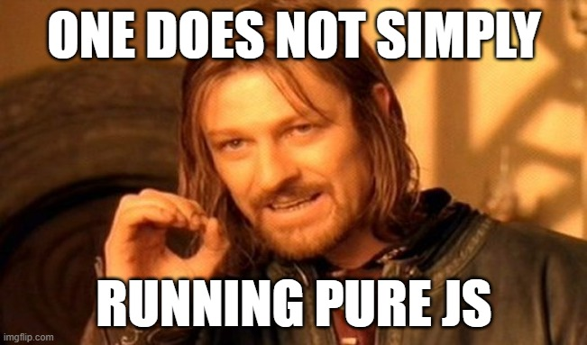
Prepare testing workspace

Slide 18
Hello, world
alert(): show message box
console.log(): show message in console
prompt(): show input dialog

Slide 19
Data Types
Primitive types: number, string, boolean
Object type: array, object
To define
Use `const` for immutable data
Use `let` for mutable data
Use `typeof` keyword to return data type

Slide 20
String Type
Immutable (read only)
Common function
indexOf()
subString()
toLowerCase(), toUpperCase()
trim()
String interpolation

Slide 21
Code Comment
// for one line comment
/* */ for multi line comment
In VSCode, use Ctrl + '/' as shortcut

Slide 22

Operator
Arithmetic operator: + - * / % ++ --
Bitwise operator: & | ^ << >>
Assignment operator: = += -=
Comparison: == != === !==
3 == '3'
3 !== '3'

Slide 23
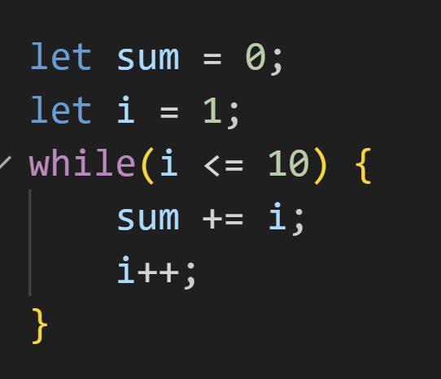
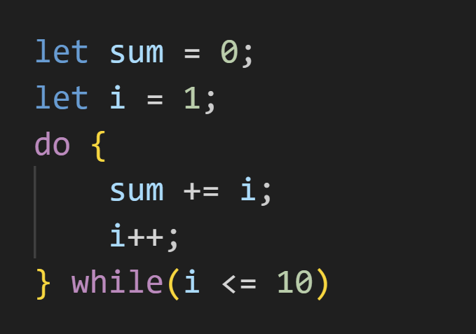
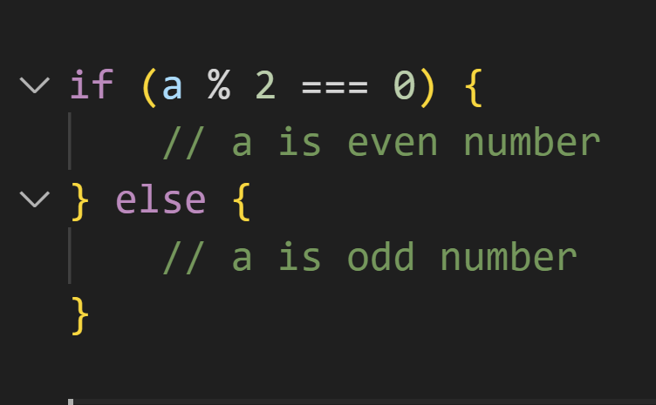
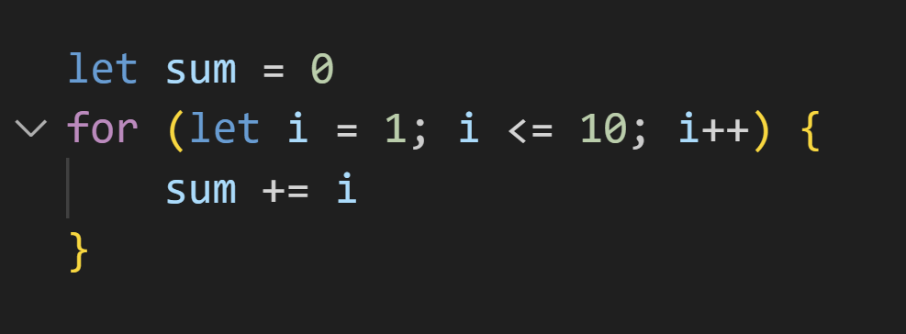
Control Flow
If - else
Do-while
While
For

Slide 24

Quiz
Check whether X is prime number

Slide 25
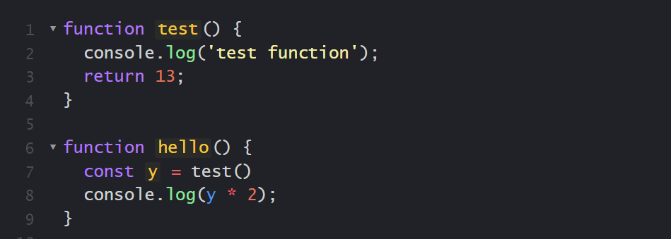
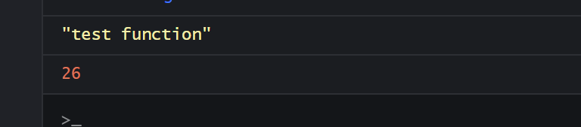
Function
Keyword 'function'

Slide 26
Array
Collection of data
Inline define in bracket [] with comma (,) as seperator
Access element in array by [index]
Get array size by property 'length'

Slide 27
push / pop / shift / unshift
push() / pop(): add or remove element from end of array
unshift() / shift(): add or remove element from beginning of array

Slide 28
arrA.concat(arrB)
concatinate two array
return new array

Slide 29
slice(start, end)
extract part of array, return new array
has 2 parameters (start, end)
`end` is optional parameter

Slide 30
splice(start, deleteCount, ...items)
Use to delete or insert items to `start` at the same time
Return removed elements as a new array

Slide 31
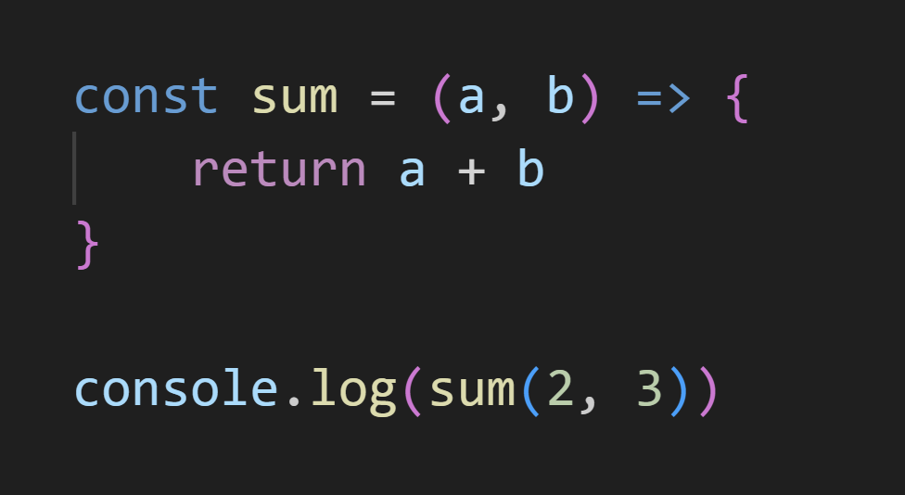
Arrow function
Shorthand to define function in Javascript

Slide 32
forEach(fx)
Loop throught array by calling to function in each loop
`fx` is function which can has parameter (elem, index, arr)
elem: current accessed element
index: current index
arr: array itself

Slide 33
map(fx)
Loop throught array, call passing function then create new array from function result
Parameter is mostly same as forEach()

Slide 34
filter(fx)
Loop throught array, call passing testing function, return new array of element which testing function return TRUE
Parameter is mostly same as forEach()

Slide 35
Quiz
From Input Array [1, 2, 3, 4, 5]
Write code to return array
Return [10, 20, 30, 40, 50]
Return [10, 21, 32, 43, 54]
Return [10, 2, 30, 4, 50]
Return [2, 4]

Slide 36
Object
Construct object
Accessing / Modify object property
Remove object property

Slide 37
Typescript
Javascript + Type + More stuff...
Keyword `interface`
Can test typescript via command line

Slide 38

Basic React

Slide 39
Let’s Start
First, create new project.
npm create vite@latest
Create new project by using typescript.
npm create vite@latest {project-name}-- --template react-ts

Slide 40
Next Step
Go to project and install package.
cd {project-name}
npm install
After that, start project.
npm run dev

Slide 41
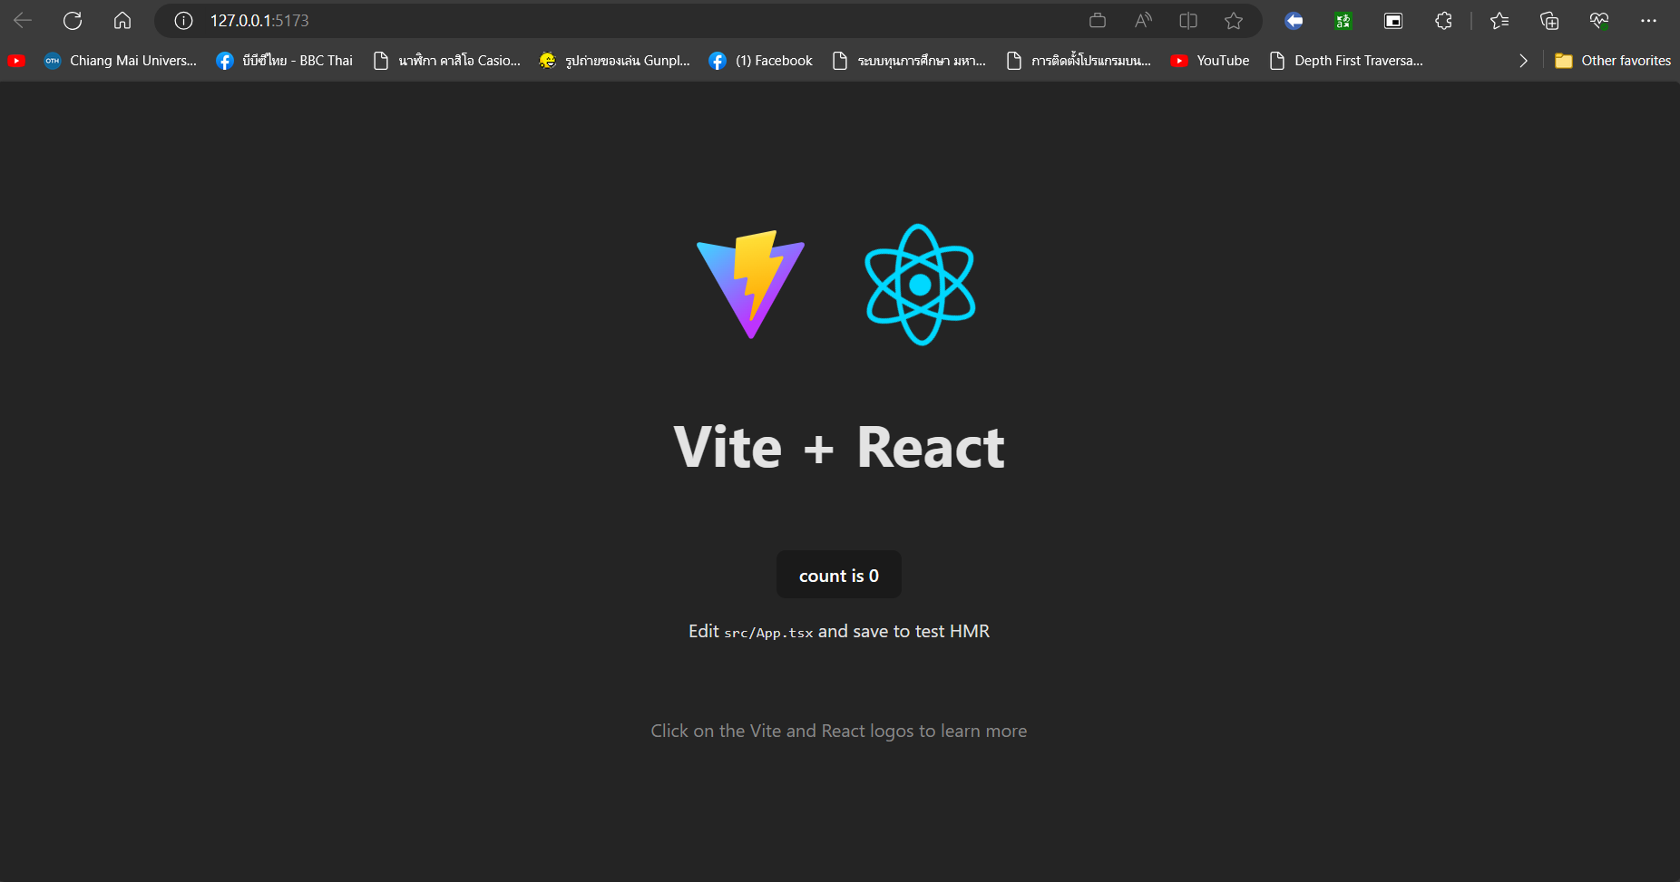
1st time running page from scratch

Slide 42
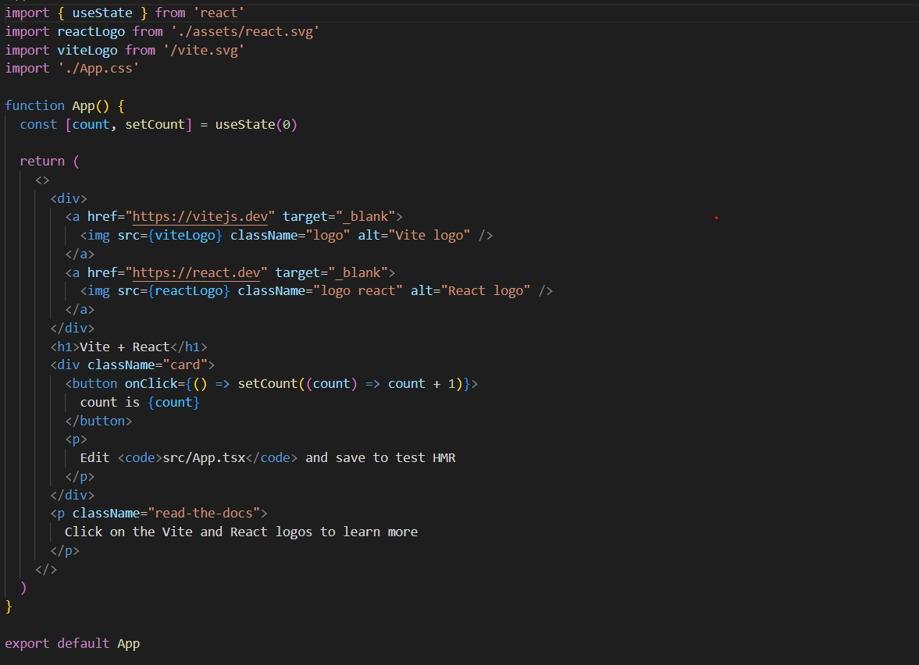
Import library/component/CSS
Function Component
Return HTML Element.

Slide 43
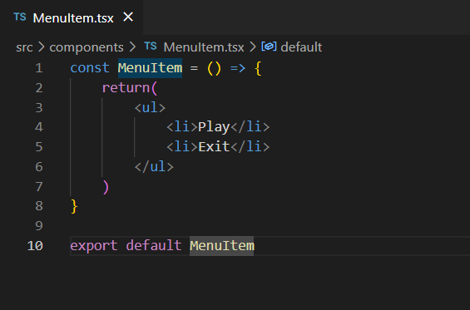
Create new component.

Slide 44
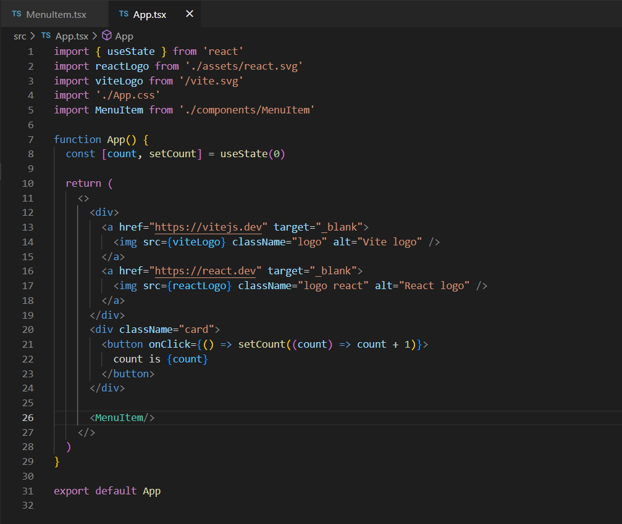
Import and use component.

Slide 45
Parent/Child component.
Parent Component
Child Component

Slide 46
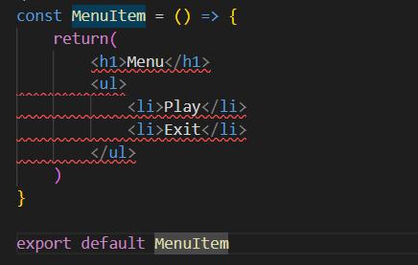
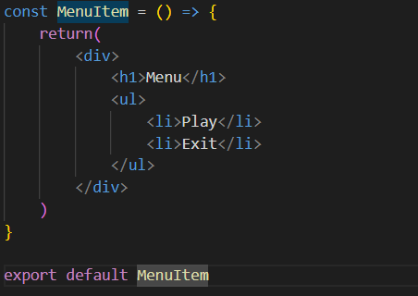
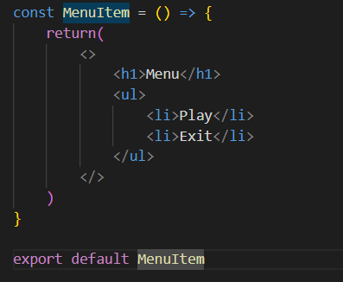




Component.
In one component, it should return only 1 HTML element.
If you need return many HTML element, you should wrap these element by use <div> or <> tag.

Slide 47

How to use CSS in React.
Inline styling
JS object
CSS Stylesheet
CSS modules

Slide 48
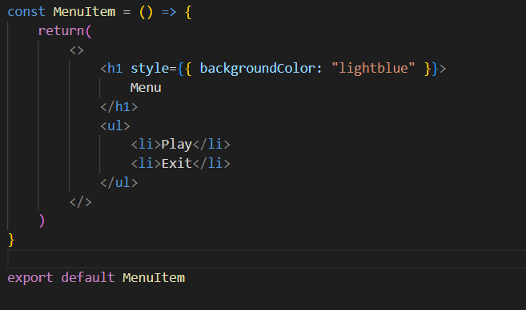
Inline Styling

Slide 49
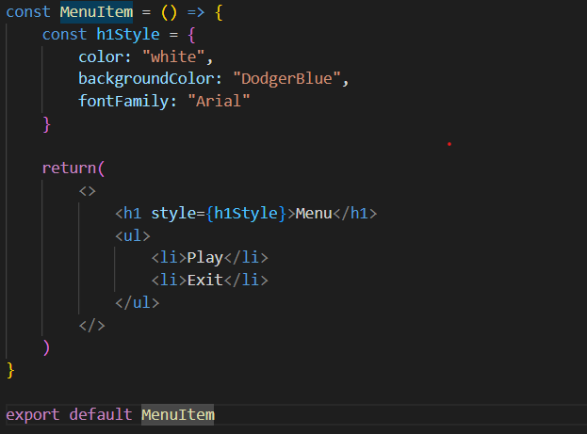
JS Object

Slide 50
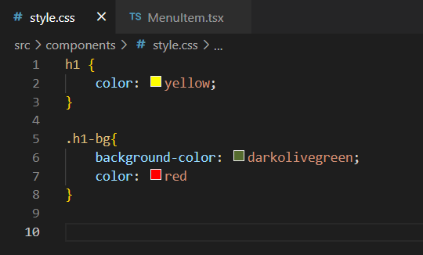
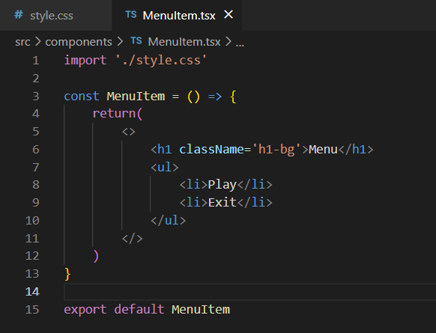
CSS Stylesheet

Slide 51
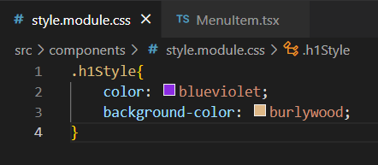
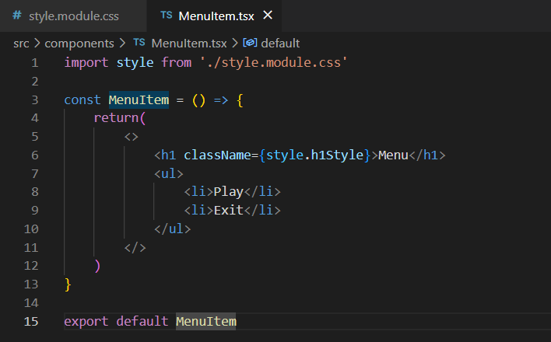
CSS Modules

Slide 52
Example code React app

Slide 53

Nook Section

Slide 54

Before Start
1. Get the example code
Please clone or download the example code from https://github.com/mycostech/react-cs-cmu
2. Open in VS code
Open this folder code in VS code
3. install and run in development mode
Open terminal, hit command npm run install and npm run dev

Slide 55

So, What next?
From now on

Slide 56

Every Section
Focus
Everybody focuses on the demo from me no need to try to write following the demo.
Practice
After demo, we will do a practice, 5 mins
Hint
No worry about codes, I will show all practice answer code in Pull request

Slide 57

Speaker: NOok
Sections
1
Component
2
Props
3
State
4
Event
5
JSON

Slide 58
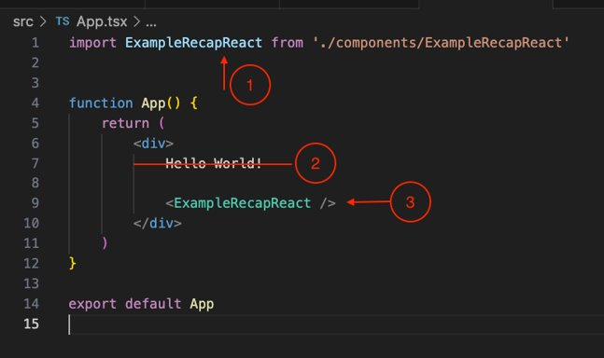
Show component
Good first practice
In App.tsx
STEPS
1. Import a component
2. Remove old string
3. Use the component in App.tsx

Slide 59
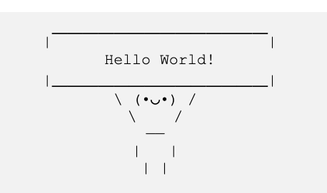
Show be like

Slide 60
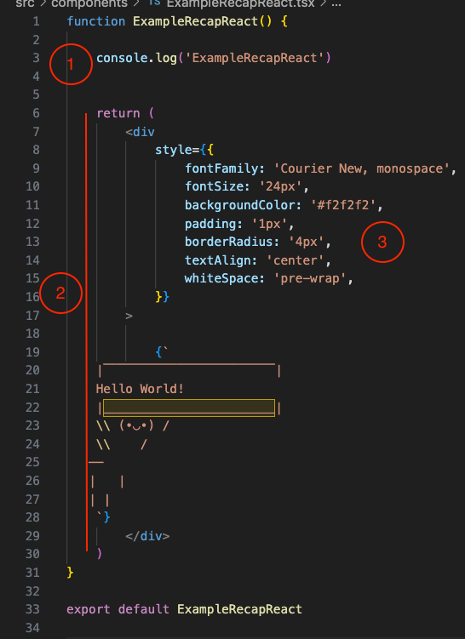
Recaps
1
Statement code, procedure section
2
JSX syntax, after return
3
Inline style

Slide 61
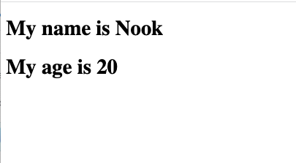
Challenge: Show your name and age
Step 1
Create a component name: ShowNameAndAge.tsx
Step 2
Show name and age, can use any html tag
Step 3
Import this component and use in App.tsx

Slide 62

Tips
Naming
Naming a component and file names with Capitalize, Pascal Case
Default Export
We can name any import component from Export default but usually use the same name.
Less is Good
Prefer many components, one component does one thing, better than many lines of codes

Slide 63
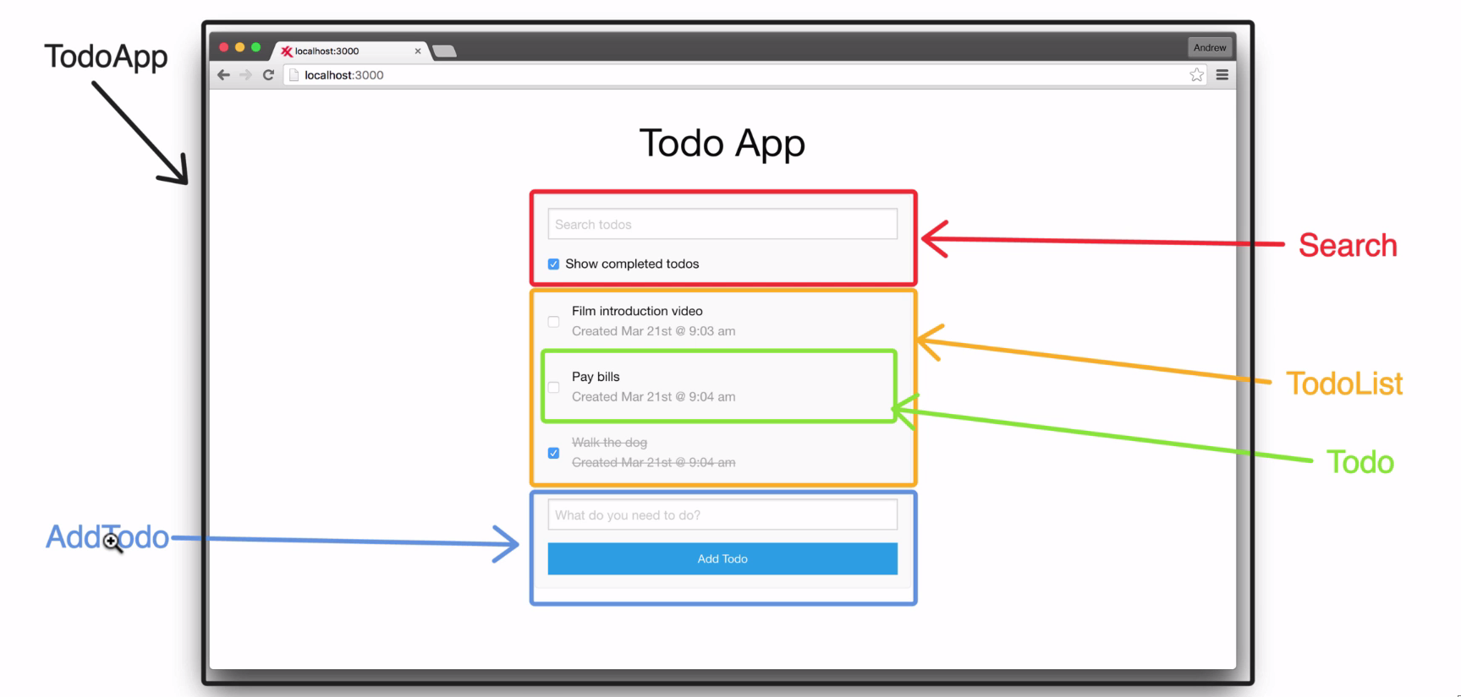
React: World of Components

Slide 64
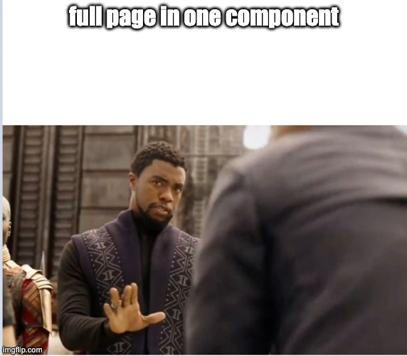
React: World of Components

Slide 65
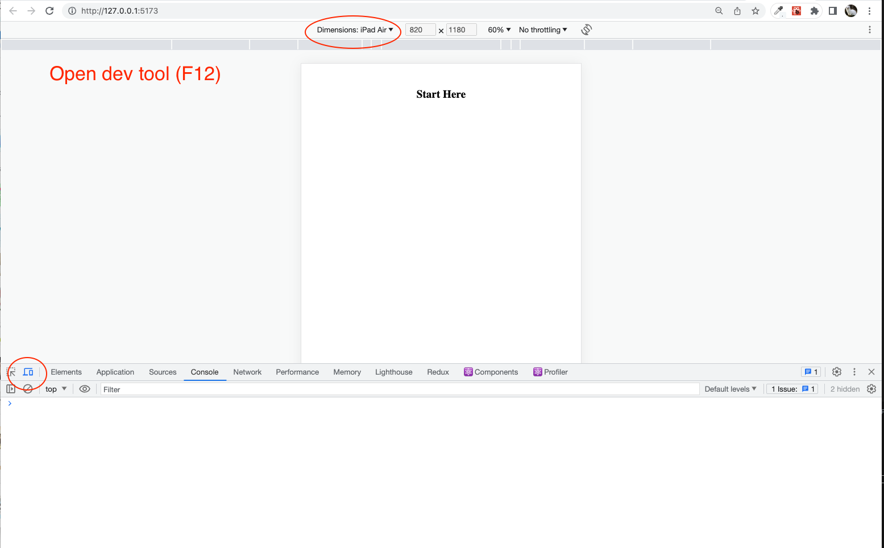
Web Screen Size?

Slide 66
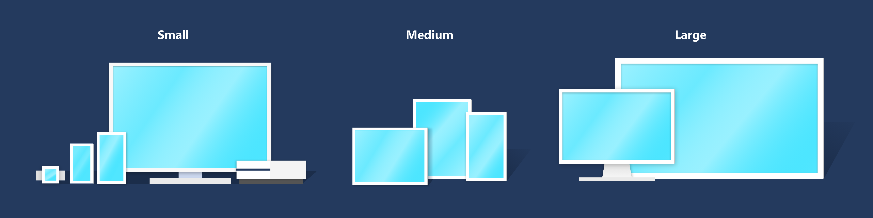
Default breakpoints
Each breakpoint (a key) matches with a fixed screen width (a value):
xs, extra-small: 0px
sm, small: 600px
md, medium: 900px
lg, large: 1200px
xl, extra-large: 1536px

Slide 67
Our Best component design Framework
https://mui.com

Slide 68
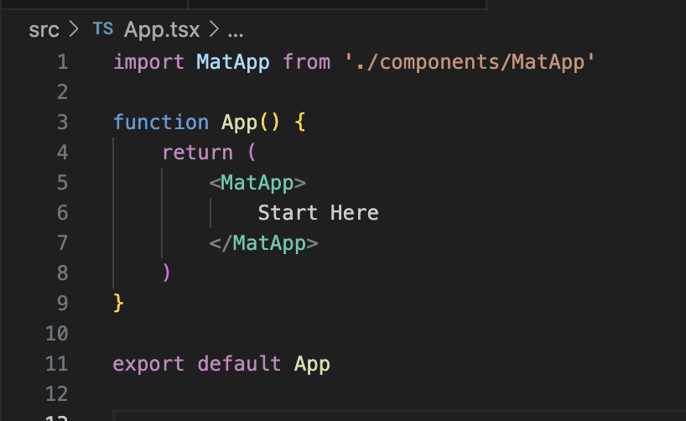
Start Material App

Slide 69
Design System:
Grid?

Slide 70
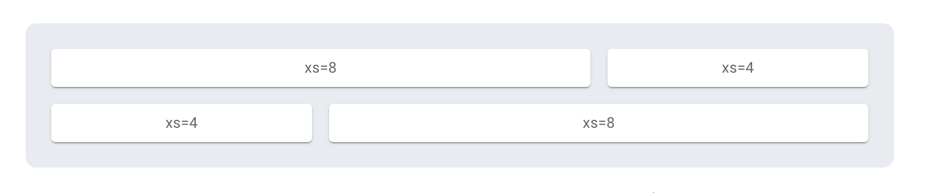
Basic grid
Column widths are integer values between 1 and 12; they apply at any breakpoint and indicate how many columns are occupied by the component.

Slide 71
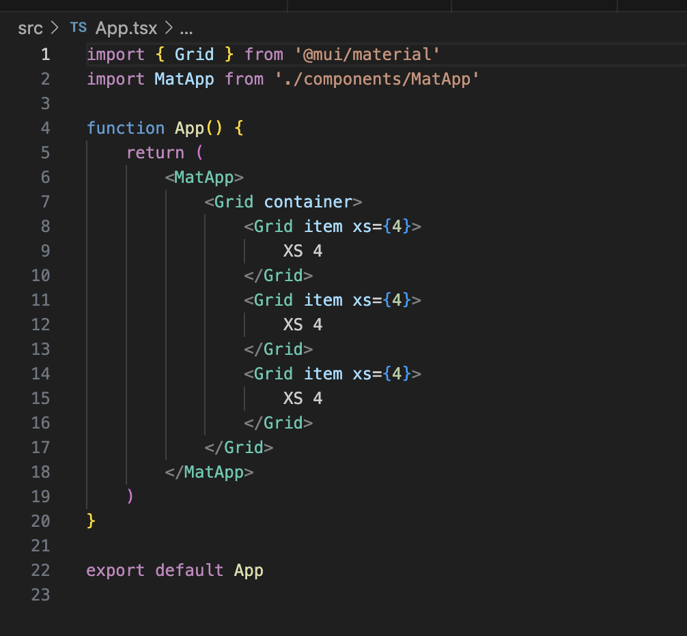
Basic grid
Responsive?

Slide 72

Section Two: Props
Short for
Rule
properties
cannot be changed
What is Props
"props" are a way to pass data from parent to child components.

Slide 73
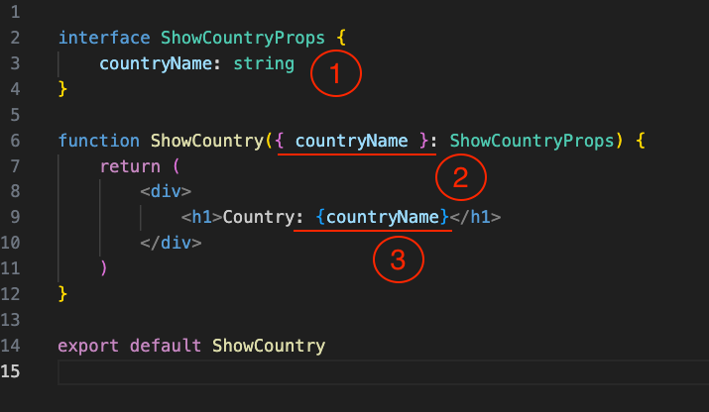
Example passing Props
1
Declare interface of component
2
Declare a variable for use in component
3
Use the countryName in JSX

Slide 74
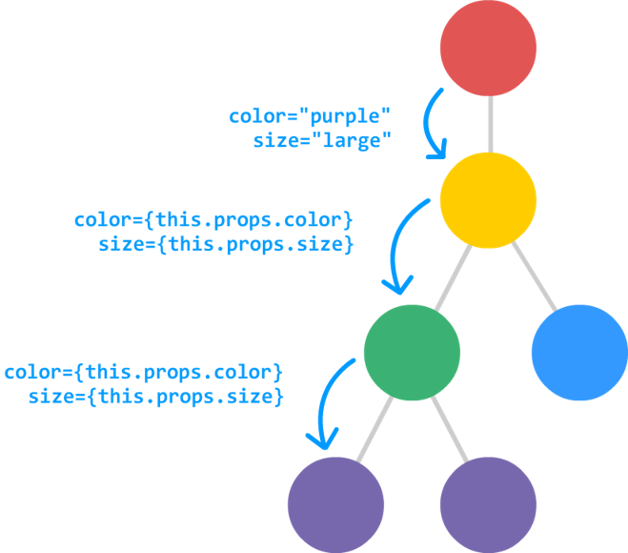
harder example
Section Two: Props

Slide 75

Challenge
Step 1
Back to use ShowNameAndAge component
Step 2
Create an interface and make Name and Age to be props
Step 3
passing name and age via App.tsx

Slide 76
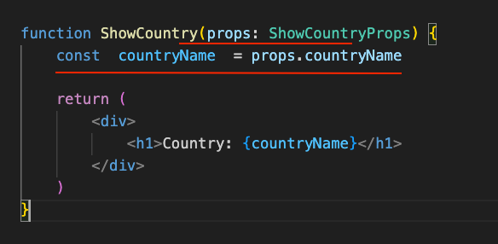
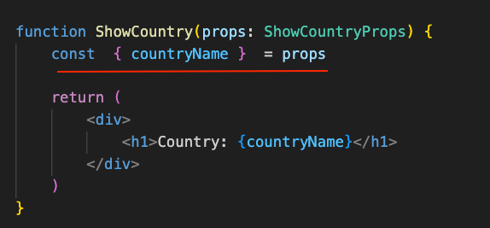
Tips:
Declare variable from props
Old style
Modern
From props, we declare countryName and get data from props.countryName
Object destructuring syntax in JavaScript. It allows you to extract specific properties from an object and assign them to variables with the same name.

Slide 77
Hard to naming interface?
Tips
Name exactly with component + Props
“ShowCountryProps”
Hard to type?
We can use any type to bypass TS error but don’t recommend.
“name: any”
Naming props
usually name with camel Case that first start will be lowercase.

Slide 78
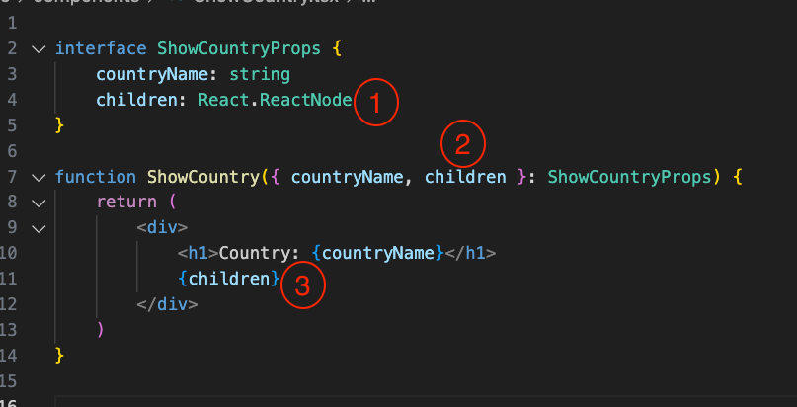
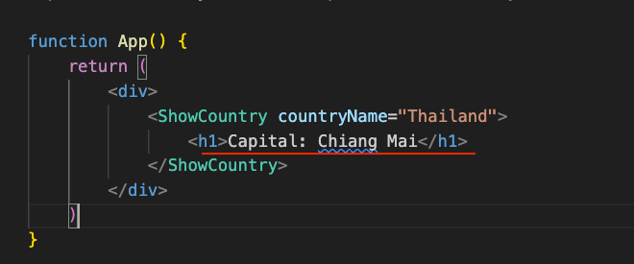
Special Props
Children props
It represents the content enclosed between a component’s opening and closing tags when used in JSX. It allows you to pass complex content, such as other components, text, or elements, to a component and access it within the component using props.children.

Slide 79
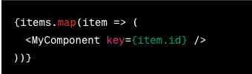
Special Props: Key
Key props,
The key prop is used when rendering a list of components in React. It is a special prop that helps React identify each component uniquely in a list. The key prop should be assigned a unique value for each component within a list. React uses the key prop to efficiently update and reorder the list when necessary. It is recommended to use a unique identifier, such as an ID or a unique attribute, as the value of the key prop.

Slide 80


Slide 81
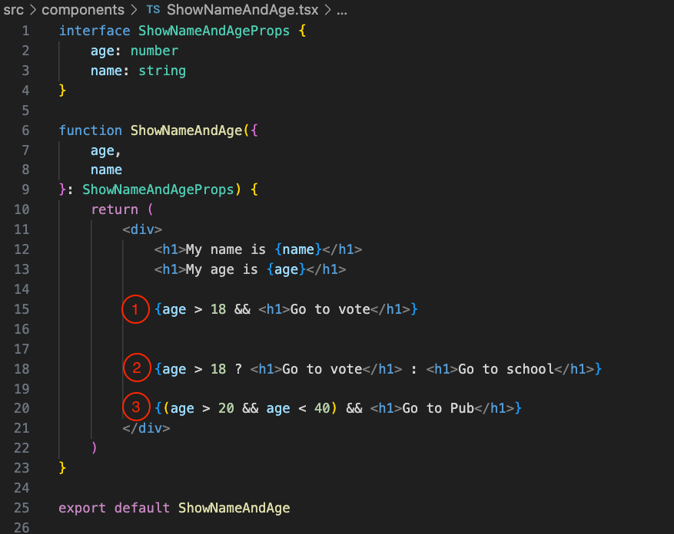
Before next section, Condition in JSX
1
IF, one condition no else
2
IF – ELSE, condition
3
IF, Multiple condition && = and, || =or

Slide 82
Section Three:
State
“The state of a component in React is an object that holds data specific to that component, allowing it to manage and update its own data over time, enabling dynamic behavior and rendering in response to changes.” – Chat GPT

Slide 83
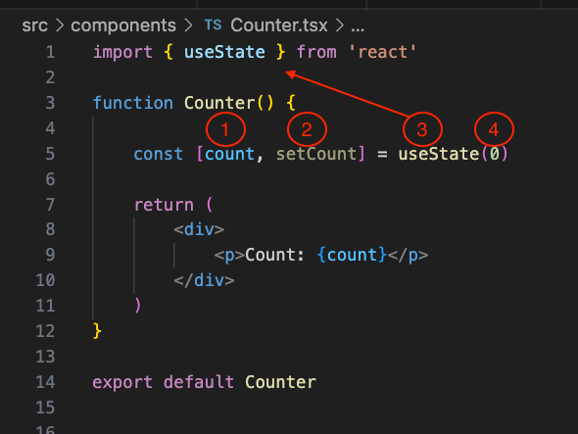
Declare State
1
Current state value
2
Function for setting a new state
3
The useState Hook API
4
Default state from an initial component

Slide 84
Fact of Hook
1 React API, or create custom API
2 always start with use..... camel Case
useState, useEffect, useMom
3 not required JSX to return
4 mostly used for handle business logic
Separate logic out from UI for clean code

Slide 85
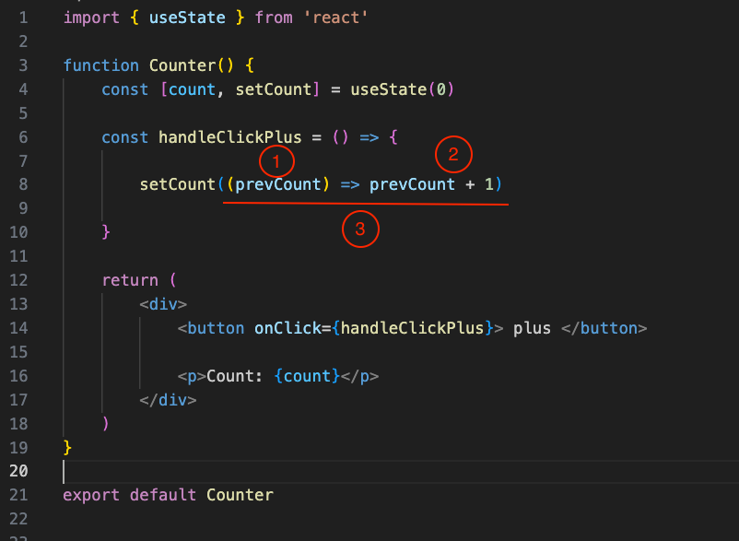
How to change state
We create the new function call handleClickPlus for handling onClick and change state
Then, use HTML button onClick to show in UI
1
Callback parameter
2
Business logic inside callback function
3
Callback function

Slide 86
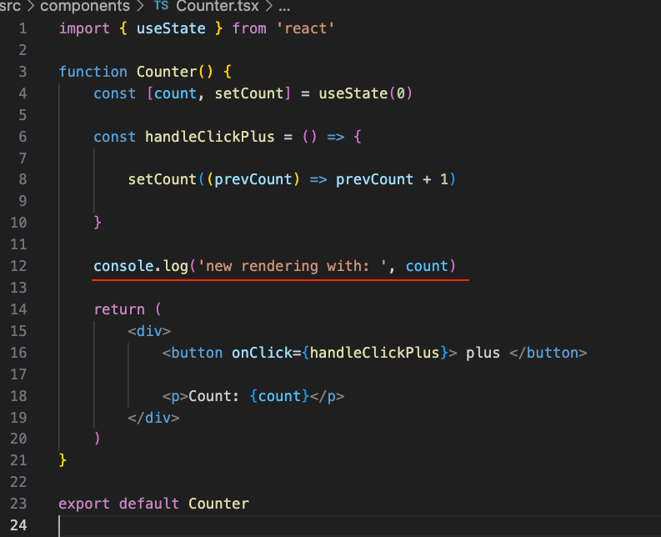
React re-render
New state trigger a re-render of the component.

Slide 87

Material Version

Slide 88

Deep Dive in the setState Callback
1
Has one statement, do and return at once
2
If we need multiple statement codes, start with curly brackets and return it
3
Bad and wrong callback, Why?

Slide 89
Challenge
Step 1
Create a Counter component like in this slide and import it in App.tsx
Step 2
Add a minus function that removes the count state by one
Step 3
Show Text “Awesome” on count is even number.

Slide 90
Section Four:
HTML Event
HTML events are handled using event handlers, which are functions that are executed when a specific event occurs on an HTML element. Event handlers in React are written in JavaScript and are attached to JSX elements using props.

Slide 91

onClick Event.

Slide 92

First Text input box
We create a new input type text to show text-box in HTML

Slide 93

Textfield from MUI

Slide 94

OnChange Event
It will trigger every hit change in the input
1
Declare event type with TS
2
onChange props from <input />
3
Pass function that receive function callback from onChange
Notes:
Why target? In the context of events in JavaScript, the target property refers to the DOM element that triggered the event

Slide 95

OnChange Event
Deep drive each onChange function callback
1 Function composition (f ∘ g)(x) = f(g(x))
Passing a function reference as an event handler. It involves directly passing the function reference.
2
Inline function as an event handler, Define new function inside onChange
3
Anonymous function
Notes:
Why target? In the context of events in JavaScript, the target property refers to the DOM element that triggered the event

Slide 96

What wrong?
Notes:
Why target? In the context of events in JavaScript, the target property refers to the DOM element that triggered the event

Slide 97

Use state to receive value
1 define state with useState Hook API
Set default with '' empty string
2
Get value from onChange event and set the new name state
3
Show current state in JSX
Notes:
Why target? In the context of events in JavaScript, the target property refers to the DOM element that triggered the event

Slide 98

Challenge
Step 1
Create a InputMyNameAndAge.tsx like in this slide and import it in App.tsx
Step 2
Add Age input and age state
Step 3
Show name and Age in ShowNameAndAge.tsx

Slide 99

Before next section Introduce useEffect Hook
useEffect is a React hook used for handling side effects in functional components.

Slide 100
Section Five:
JSON
JSON (JavaScript Object Notation) is a lightweight data format used for organizing and exchanging structured information between systems. It is easy to read and write and supports various data types.

Slide 101

JSON types
1 string
2 number
Both integer and float
3 Boolean
4 Object
JSON can be nested object
5 Array (Object)
JSON can be array (but it is Object)

Slide 102

Show JSON in React
1 Car Interface
Create interface for user’s car JSON
2 Job Interface
Create interface for job's JSON
3 User Interface
Create for user interface
4 Interface of Component
Create an interface for component props

Slide 103

.Map ?
map is a method in JavaScript that transforms each element of an array using a provided function, resulting in a new array with the transformed values. It's commonly used for tasks like extracting specific properties or performing calculations on array elements.

Slide 104

Use the user.json and ShowUSerJSON component in App.tsx

Slide 105

Show JSON in Material App ?

Slide 106


Asynchronous programming
Asynchronous programming in JavaScript allows tasks to be executed independently without blocking the main execution thread. It uses callbacks, promises, and async/await to handle asynchronous operations. This enables JavaScript to perform time-consuming tasks in the background while keeping the program responsive and improving user experience.
.then .promise
Resolve, Reject

Slide 107

Fetch User API
1 import user json example
2 Fake waiting time
3 Simulate get user api function

Slide 108

Use in Component

Slide 109

Challenge
Step 1
Store the user from API withreact useState
Step 2
Show user detail in ShowUserJSON.tsx
Step 3
Show Loading before got user result from API

Slide 110


Let’s create Match Up game

Slide 111


Step 1: Create First Card
Create folder name "Card", then create file name "Card.tsx" and "card.css" in this folder.
Card.tsx
card.css

Slide 112


Step 2: Flip Card.
Create state and function for click event in "Card.tsx".
And add more CSS in "card.css"
card.css
Card.tsx

Slide 113


Step 3: Flex Board.
Create folder name "Board" in " components" folder, then create file name "Board.tsx"
After that, go to "App.tsx" and then import Board component.
App.tsx
Board.tsx

Slide 114


Step 4: Board & Card
First, create file name "AllCard.ts" in folder name "components" this file contains interface, type and card object.

Slide 115


Step 4 (Cont.)
Second, Go to "App.tsx", import AllCard ovject and ICard interface to this component. Then create "cardIdArray" and pass as props to "Board" component.

Slide 116

Step 4 (Cont.)
Third. In "Board.tsx", Import "ICard" interface and use this to create new interface name "BoardProps" for Board component. Then use props name "cards" to create "Card" component by using Array.map.

Slide 117


Step 4 (Cont.)
Forth. In "Card.tsx", Import "ICard" interface and use this to create new interface name "CardProps" for Card component.

Slide 118

Step 5: Game Logic
First. In "Card".tsx", Add new property to "CardProps" interface. Then, edit "handleClick" function.

Slide 119

Step 5 (Cont.)
Second. In "Board.tsx", Import "useState" and "useEffect" from "react" and create function name "matchCard" for check is 2 card is match?

Slide 120

Step 5 (Cont.)
Third. Create state for clear card, open card and disable all card. After that, create handle function for click event when user click card and create funtion for check is card flip?

Slide 121

Step 5 (Cont.)
Forth. Create useEffect hook for check card when user open 2 card.

Slide 122

Step 5 (Cont.)
Fifth. In component that is returned. Add "pointerEvents" css property to <div>. Then, in "Card" component, add more property to this component.

Slide 123


Slide 124
Thank you

